Slide 1


CSE 163
Joins / Spatial Indices
Hunter Schafer

Slide 2
Matplotlib
Last time we showed how to plot 2 graphs on the same plot
Terminology is a bit important so I wanted to cover that again
There are two fundamental concepts for matplotlib
Figure (canvas to draw on / entire picture)
Axis (an individual plot inside the figure)
The subplots method conveniently returns a new figure and axis
fig, ax = plt.subplots(1)

Slide 3
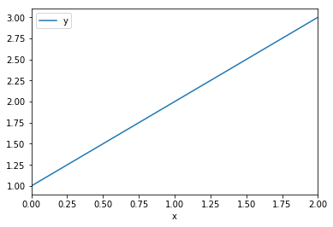
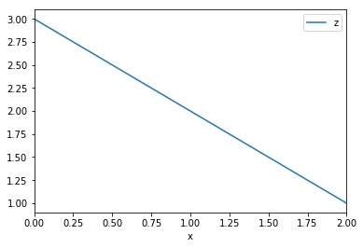
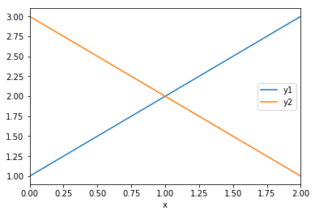
Matplotlib Example
df.plot(x='x', y='y')
df.plot(x='x', y='z')
plt.show()
fig, ax = plt.subplots(1)
df.plot(x='x', y='y', ax=ax)
df.plot(x='x', y='z', ax=ax)
fig.show()
x | y | z
1 | 1 | 3
2 | 2 | 2
3 | 3 | 1

Slide 4
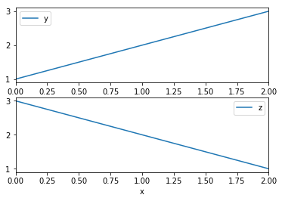
Matplotlib Example
df.plot(x='x', y='y')
df.plot(x='x', y='z')
plt.show()
fig, [ax1, ax2] =
plt.subplots(2)
df.plot(x='x', y='y', ax=ax1)
df.plot(x='x', y='z', ax=ax2)
fig.show()
x | y | z
1 | 1 | 3
2 | 2 | 2
3 | 3 | 1

Slide 5
Dissolve
Colab
Exactly the same as a groupby for the the regular columns
For the geometry columns, overlays all of the geometries
Options for aggfunc
‘first’
‘last’
‘min’
‘max’
‘sum’
‘mean’
‘median’

Slide 6
Separated Data
Imagine that your data is split into multiple DataFrames and you want to combine them.
How can I print out the grading assignments?
tas
grading
ta_name | ta_id
Joely | 1
Dylan | 2
Nicole | 3
grader_id | student_name
2 | Hunter
3 | Erika
1 | Josh
3 | Erik

Slide 7
Combining Data
Basic Idea, write code to do something like (not real code)
This is called a join since we are joining the tables together
Find all combinations of rows that “line up” based on a value
This is such a common task, there is a method we can call to do this
for t in tas:
for g in grading:
if t['ta_id'] == g['grader_id']:
print(t, g)

Slide 8
Pandas Join
tas.merge(grading, left_on='ta_id',
right_on='grader_id')
ta_name | ta_id
Joely | 1
Dylan | 2
Nicole | 3
ta_name | ta_id | g_id | s_name
Joely | 1 | 1 | Josh
Dylan | 2 | 2 | Hunter
Nicole | 3 | 3 | Erika
Nicole | 3 | 3 | Erik
grader_id | student_name
2 | Hunter
3 | Erika
1 | Josh
3 | Erik

Slide 9
Pandas Join
tas.merge(grading, left_on='ta_id',
right_on='grader_id')
ta_name | ta_id
Joely | 1
Nicole | 3
ta_name | ta_id | g_id | s_name
Nicole | 3 | 3 | Josh
Nicole | 3 | 3 | Erika
Nicole | 3 | 3 | Erik
grader_id | student_name
2 | Hunter
3 | Erika
3 | Josh
3 | Erik

Slide 10
Type of Join
There are interesting questions of what happens if there are rows that don’t “line up”. Different type of joins differ in how to handle this case.
Types of Joins left.merge(right, how=’type’)
Inner (default): Both values must be present
Left: If a value from left has no match, add NaNs
Right: If a value from right has no match, add NaNs
Outer: If a value from either table has no match, add NaNs

Slide 11
Inner Join
tas.merge(grading, left_on='ta_id',
right_on='grader_id')
ta_name | ta_id
Joely | 1
Nicole | 3
ta_name | ta_id | g_id | s_name
Nicole | 3 | 3 | Josh
Nicole | 3 | 3 | Erika
Nicole | 3 | 3 | Erik
grader_id | student_name
2 | Hunter
3 | Erika
3 | Josh
3 | Erik

Slide 12
Left Join
tas.merge(grading, left_on='ta_id',
right_on='grader_id', how='left')
ta_name | ta_id
Joely | 1
Nicole | 3
ta_name | ta_id | g_id | s_name
Joely | 1 | NaN | NaN
Nicole | 3 | 3 | Josh
Nicole | 3 | 3 | Erika
Nicole | 3 | 3 | Erik
grader_id | student_name
2 | Hunter
3 | Erika
3 | Josh
3 | Erik

Slide 13
Right Join
tas.merge(grading, left_on='ta_id',
right_on='grader_id', how='right')
ta_name | ta_id
Joely | 1
Nicole | 3
ta_name | ta_id | g_id | s_name
Nicole | 3 | 3 | Josh
Nicole | 3 | 3 | Erika
Nicole | 3 | 3 | Erik
NaN | NaN | 2 | Hunter
grader_id | student_name
2 | Hunter
3 | Erika
3 | Josh
3 | Erik

Slide 14
Outer Join
tas.merge(grading, left_on='ta_id',
right_on='grader_id', how='outer')
ta_name | ta_id
Joely | 1
Nicole | 3
ta_name | ta_id | g_id | s_name
Joely | 1 | NaN | NaN
Nicole | 3 | 3 | Josh
Nicole | 3 | 3 | Erika
Nicole | 3 | 3 | Erik
NaN | NaN | 2 | Hunter
grader_id | student_name
2 | Hunter
3 | Erika
3 | Josh
3 | Erik

Slide 15
Geospatial Join
Colab
Goals
Plot multiple layers on a map
Find all the states that intersect the path of the hurricane
Notes
Plot layers by plotting on the same axes
Need to use a spatial join to join on geo-spatial features

Slide 16
Spatial Joins
Very similar to plain old joins (how)
Same distinction between inner, left, right
Find all pairs of matches
The key difference are you match by geo-spatial relation (op)
Most commonly will just use op=’intersects’, but there are other ways to determine a match
geopandas.sjoin(mainland, florence, op='intersects')

Slide 17
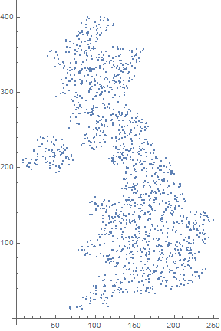
Spatial Join - Points
Imagine we had a dataset of where people live in England. Want to find all people that live in this box. How many points would we have to search through?
[Point1, Point2, Point3, …]

Slide 18
Spatial Index

Slide 19
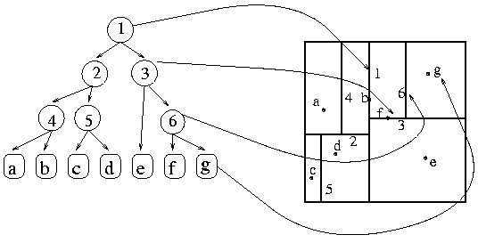
Spatial Index
This is a tree!
To find the points in a region, just follow the tree
Notes:
In this tree we can treat left on 1 to correspond to left and the right corresponds to the right of that boundary.
If we look at 3,

Slide 20
Spatial Index Performance
Say we are looking for a single Point
How much work is it if we have n rows?
Without a spatial index: O(n)
With a spatial index? O(height of tree)
How tall is the tree? How many times can we divide 1 million points in half?
1,000,000 / 2 / 2 / 2 / 2 / … / 2 = 1
2^{k} = 1,000,000
k = log₂(1,000,000) ≅ 20
This means the lookup is O(log n)
A million doesn’t sound that big. What about a tree of the US?
327.2 million people
log₂(327,200,000) ≅ 28
The US isn’t THAT big. What about a tree of China?
1.386 billion people
log₂(1,386,000,000) ≅ 30

Slide 21
Technicalities
Now this isn’t for free, the spatial index takes time to build and also takes up extra space
O(knlog(n)) where k is the dimension, n is num points
Indices are great for quickly accessing data, but they can be harder to update
It would seem easy to update the tree by adding more points, but we were assuming the tree was balanced.
In general, adding an index to your data makes it faster to read but harder to update

